Slide 1




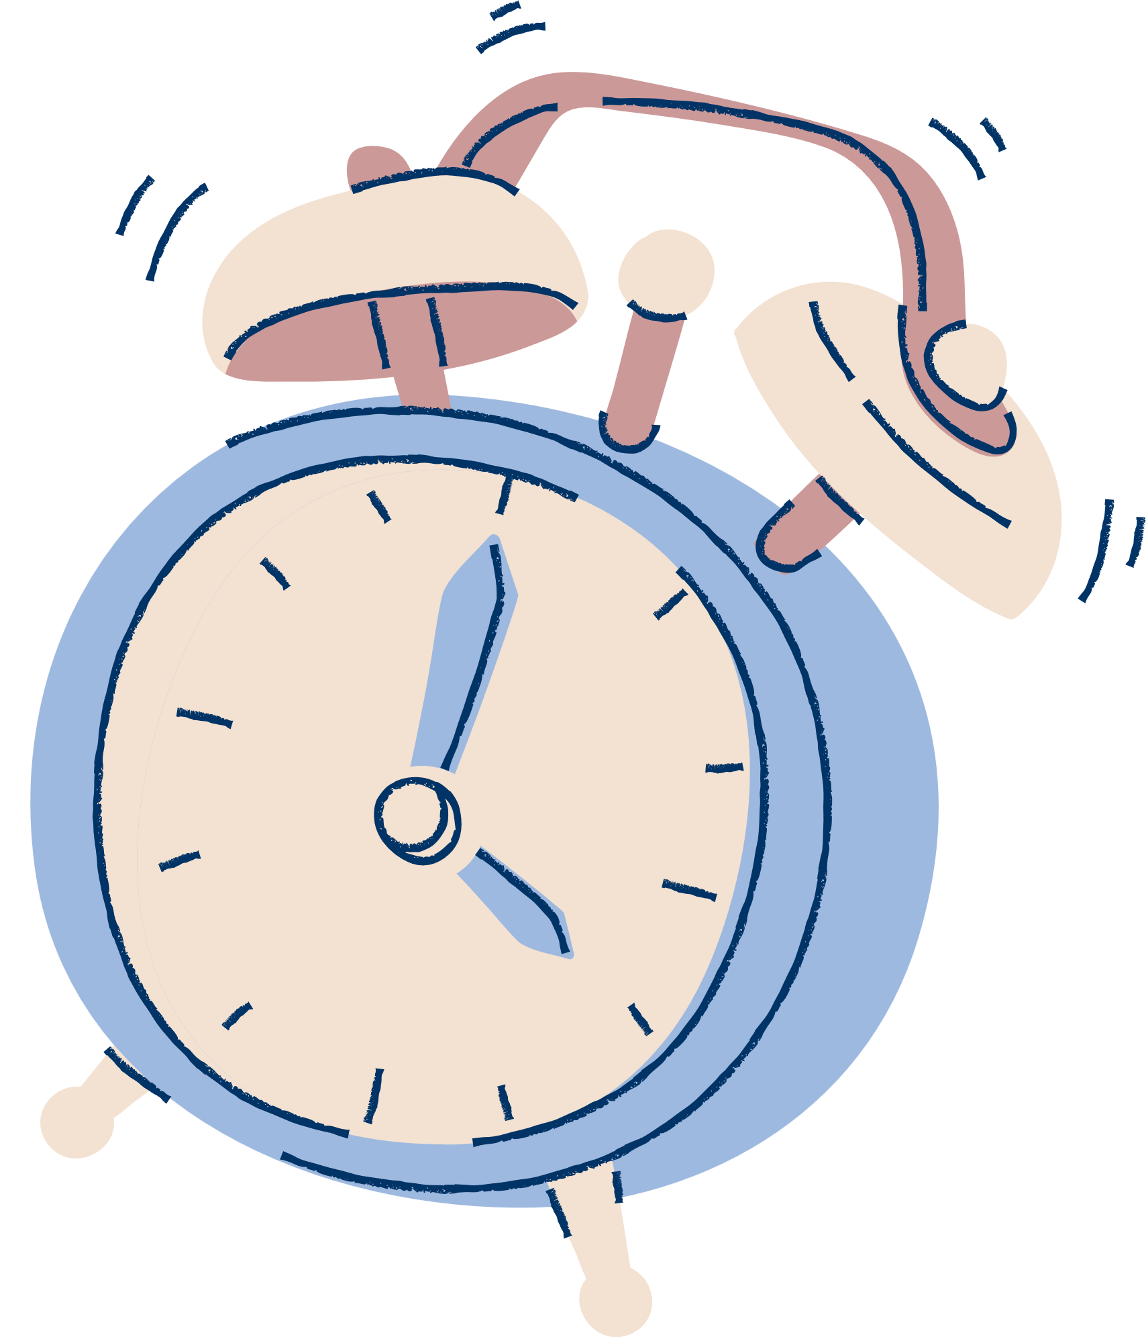
FITNESS GOAL TRACKER
guidelines to lead an expected disease-free life

Slide 2


TEAM'S MEMBERS
#1
KANIZ FATEMA
A23MJ4003
#2
#3
Abdullah Mohammad Jaid A23MJ4001
SAUMIK HASAN ARPON
A23MJ3009

Slide 3

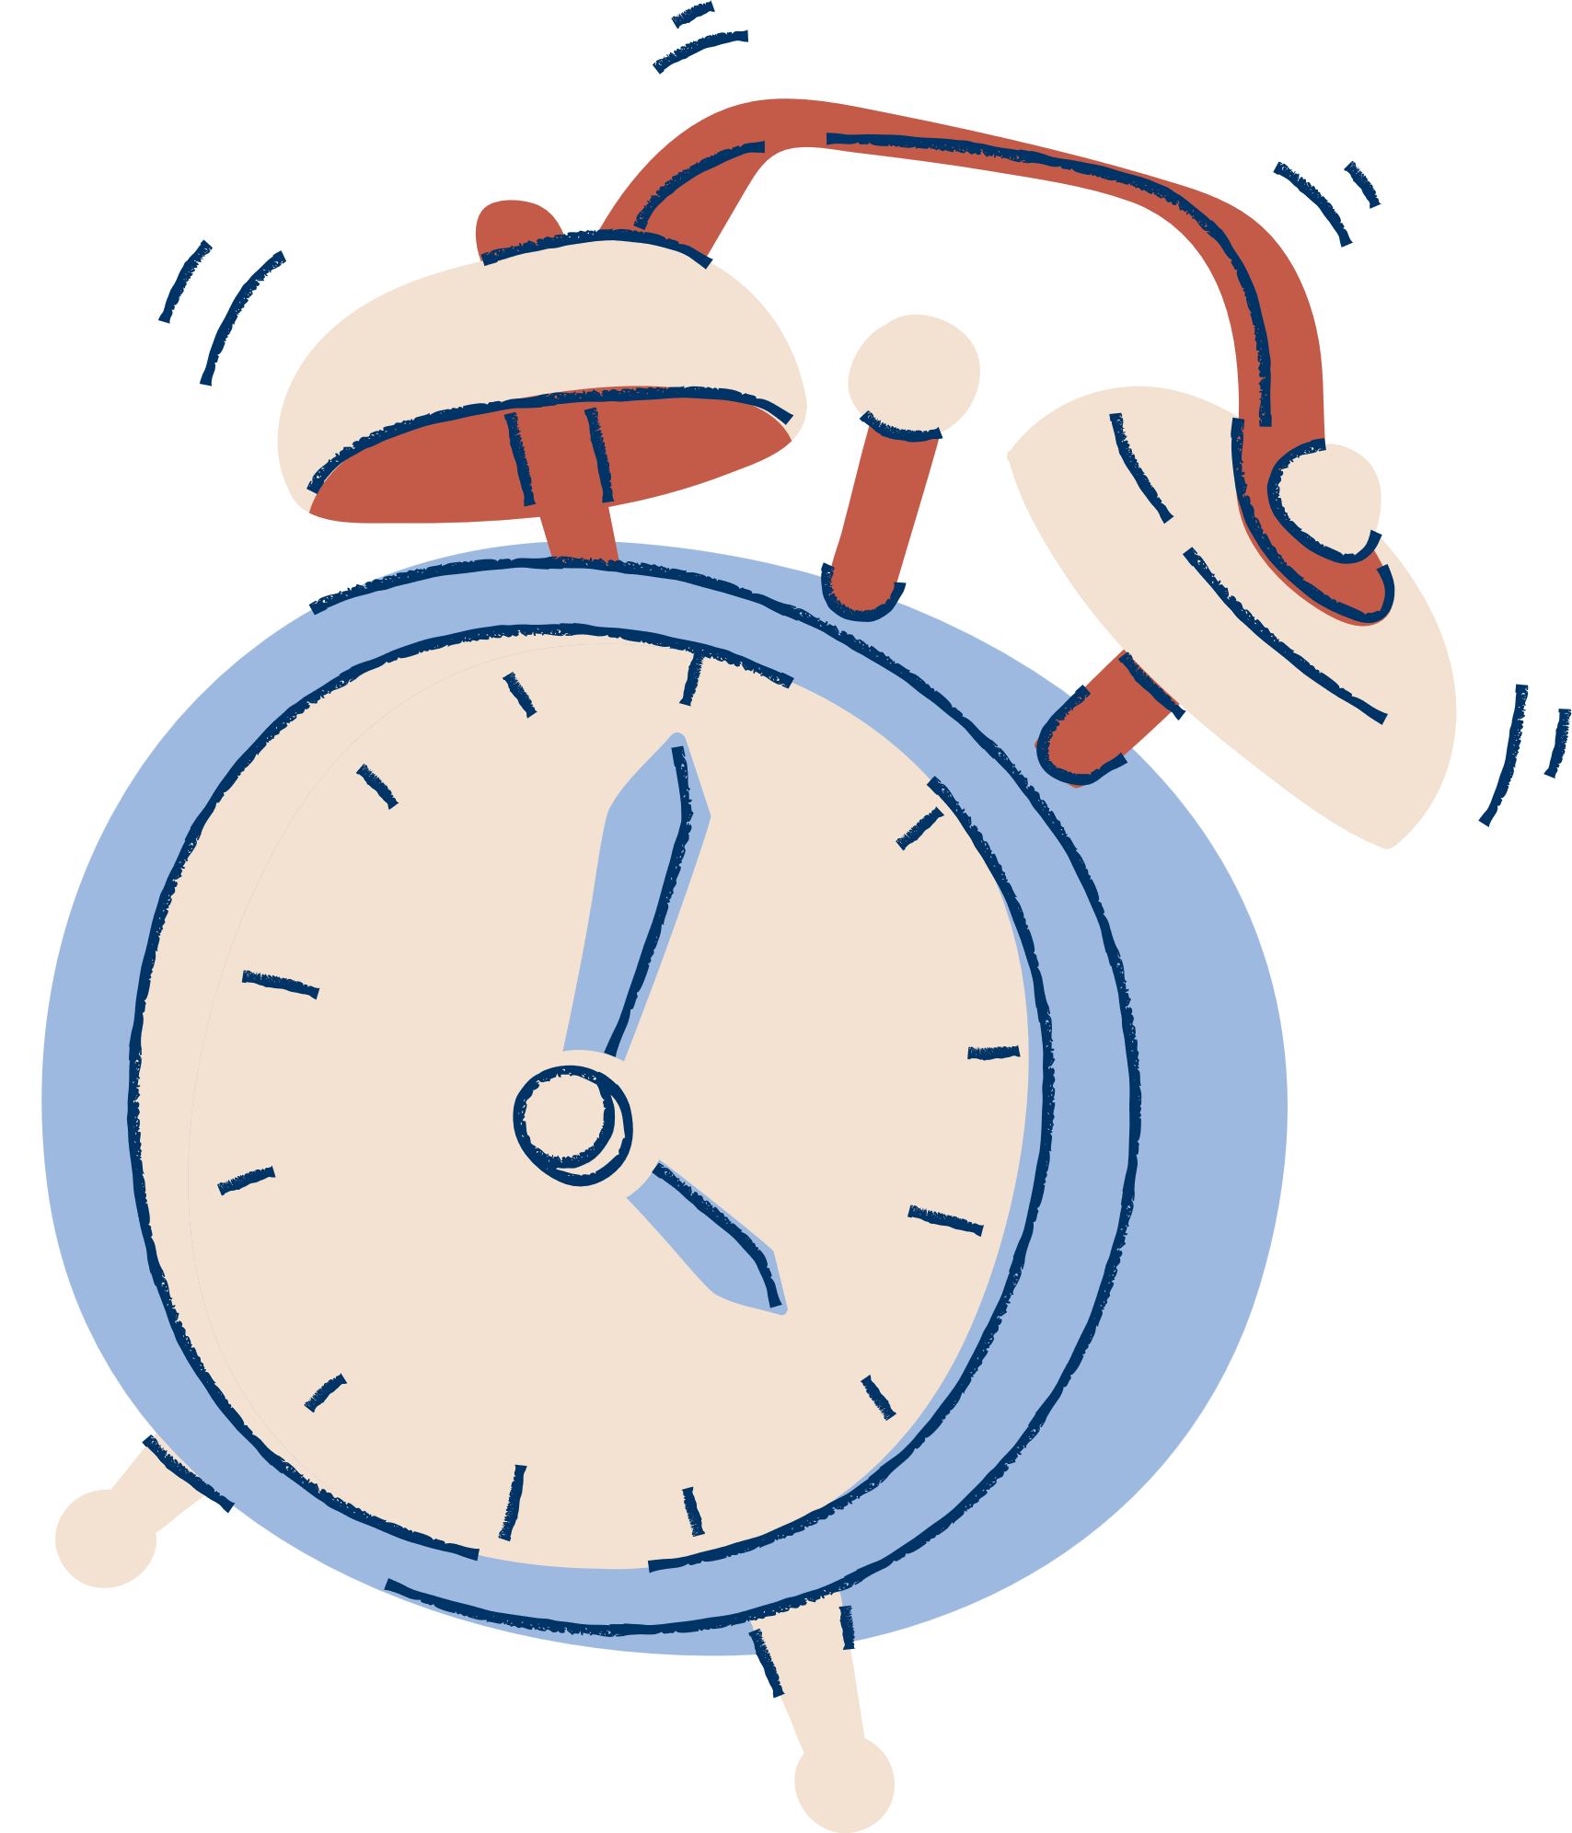


INTRODUCTION
Our project Fitness Goal Tracker is a web-based platform that will help to monitor overall health as well as a motivational tool to live a healthy life. The principal goal of this project is to provide guidelines to the user to lead an expected disease-free life.

Slide 4



OBJECTIVES
1
record the progress of daily activities
4
Motivational Reminder
2
notification tool
5
Goal Setting
3
track daily food intake along with calorie or macronutrient targets.

Slide 5
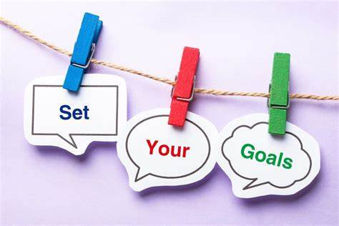

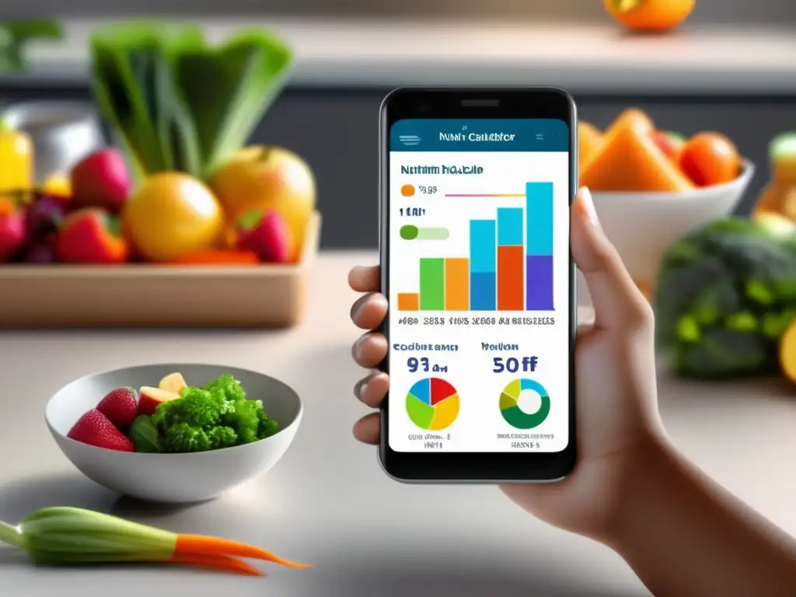


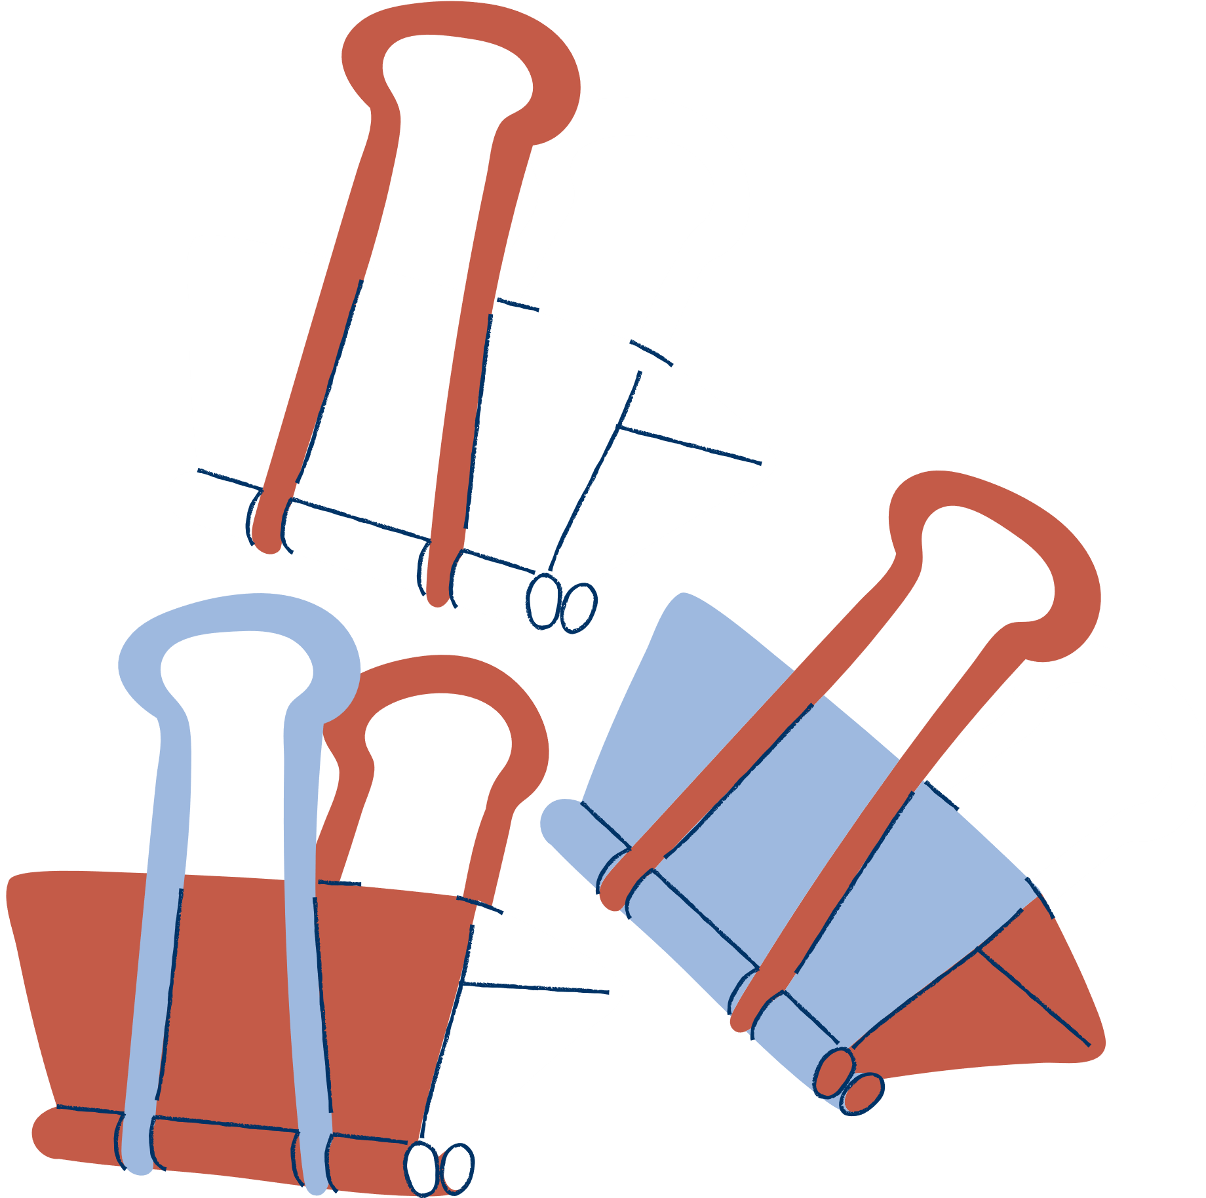


Slide 6

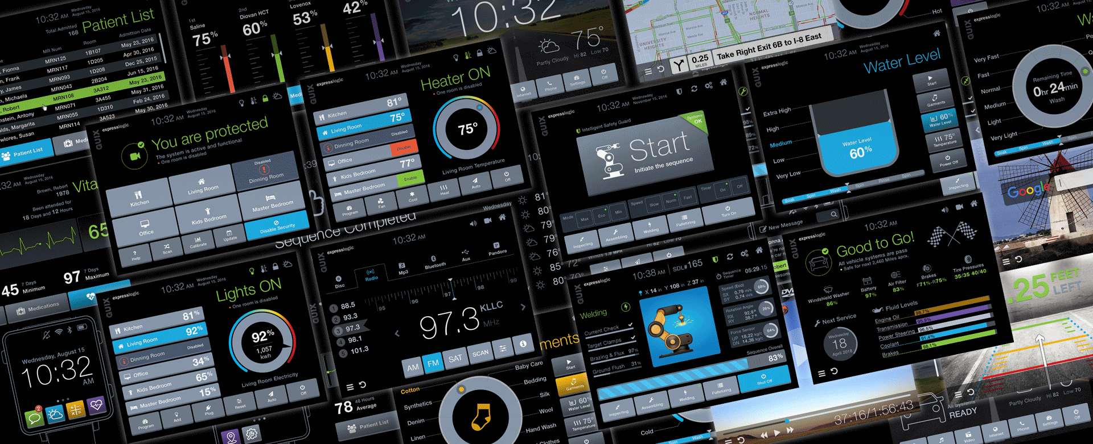
GUI DESIGN
The GUI is the part of the application with which users interact. A good GUI design ensures the application is intuitive, easy to navigate, and visually appealing.
Identify user needs and preferences.
Avoid clutter. Keep the interface clean and straightforward.
Use consistent colors, fonts, and button styles
Provide immediate feedback for user actions (e.g., confirmation messages).
Ensure that it is usable by people with various disabilities.

Slide 7
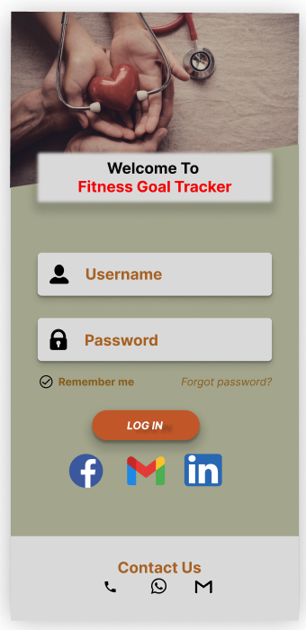
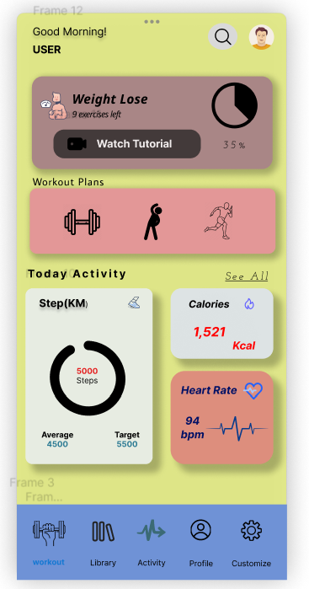
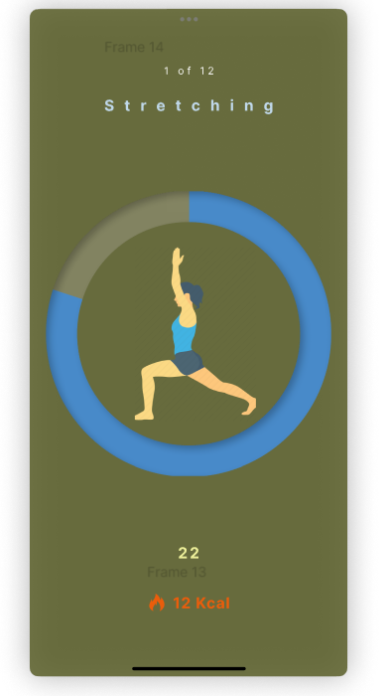
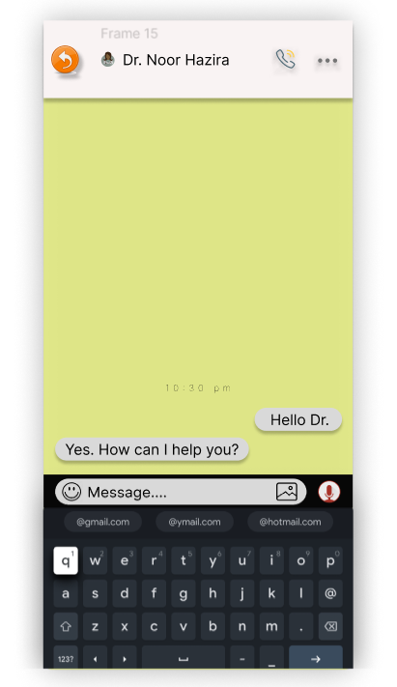
#2

Slide 8
USER GUIDE
1
Installation
3
Detailed Instructions
2
Getting Started
4
Troubleshooting

Slide 9


Daily Tracker
MONTH: JANUARY
Habit: Drink 8+ glasses of water
Summary: Goal achieved!
Morning | Status | Afternoon | Status | Evening | Status
8:00 | exercise | 1:00 |  | 6:00
9:00 | breakfast | 2:00 | lunch | 7:00
10:00 | medicine | 3:00 | medicine | 8:00 | medicine
11:00 |  | 4:00 |  | 9:00 | dinner
12:00 | fruits | 5:00 | walking | 10:00 | sleep

Slide 10





Weekly Tracker
Week: January 1-7
Date | Day | Wake up at 5 AM | Meditate | Workout | Read | Sleep for 8+ hours
January 1 | Sunday
January 2 | Monday
January 3 | Tuesday
January 4 | Wednesday
January 5 | Thursday
January 6 | Friday
January 7 | Saturday
 | Summary | 1/5 days achieved

Slide 11


Monthly Tracker
Month: January
Habit: Exercise for 30 mins.
Summary: Try better next month!
Week # | Sunday | Monday | Tuesday | Wednesday | Thursday | Friday | Saturday
1
2
3
4
5

Slide 12
APPLICATION TRIAL/RUN
1
Beta Testing
4
Performance Testing
2
User Feedback
5
Final Adjustments
3
Bug Fixing

Slide 13


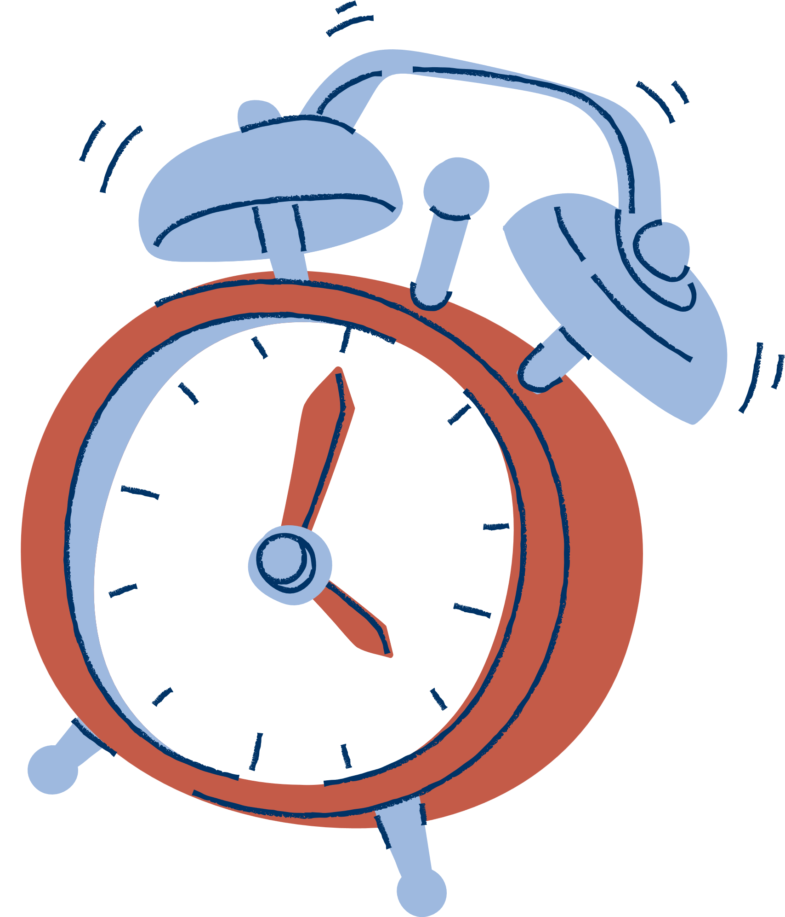


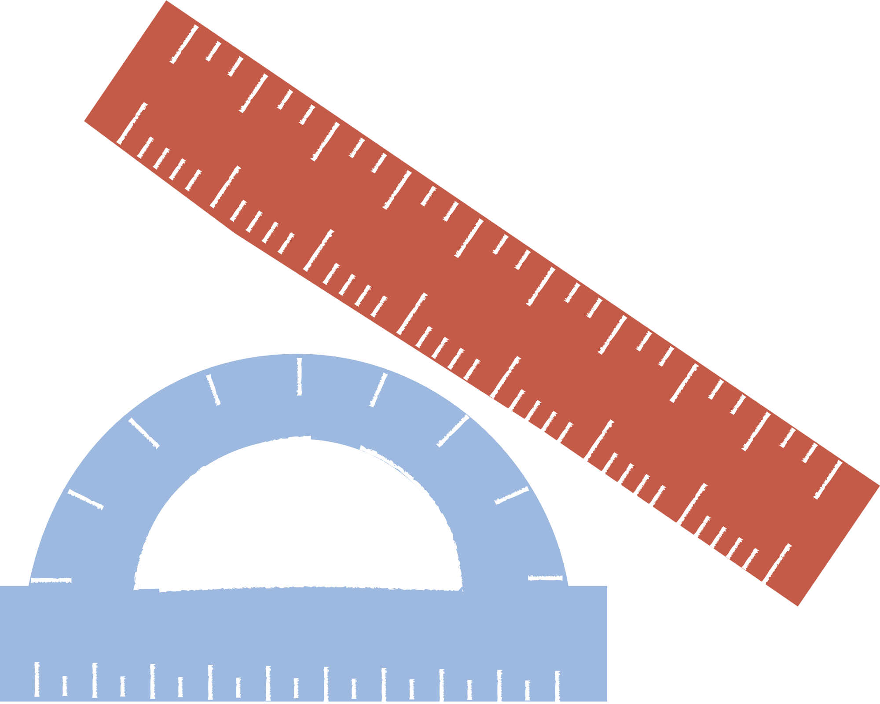

conclusion
Fitness goal tracker helps you stay organized and motivated. It can also plan your workout as per your inserted weekly, daily or monthly planning. No medicine intake will be delayed or forgotten through the reminder tool. Our project seeks to offer a comprehensive, motivated, and personalized experience to assist users effectively accomplish their fitness goals.

